Slide 1
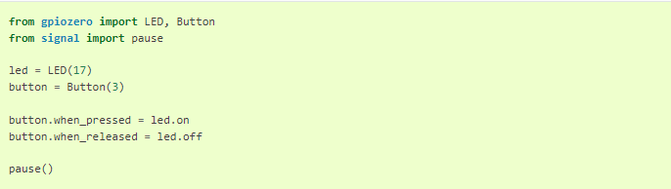
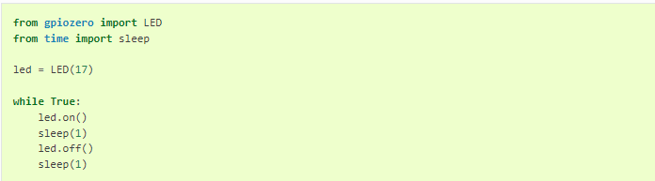
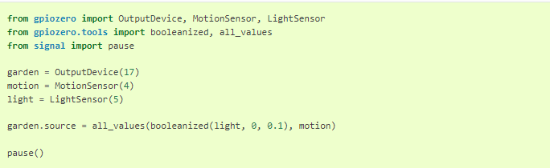
The gpiozero Library : Online Documentation
https://gpiozero.readthedocs.io/en/stable/
Demonstration of Basic Recipes - Examples

Slide 2
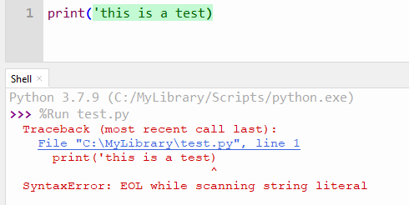
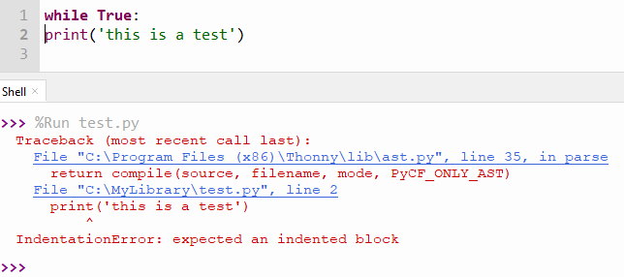
Types of Errors and how to debug Errors
Syntax Error
Convention Error – (indentation for Python)

Slide 3

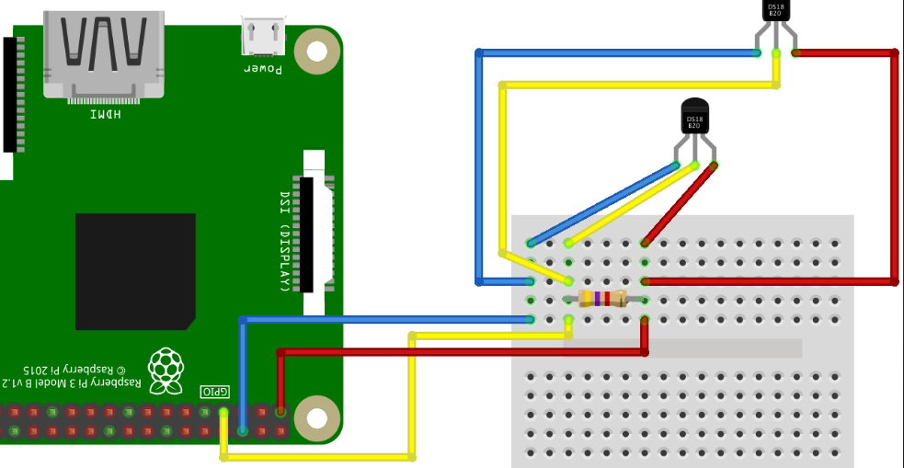
Types of Errors and how to debug Errors
Logical Error
Program is not working in the way you wanted
Circuitry Error
Wiring not done correctly
Wrong Pin used

